Slide 1
Python Programming: Final Project
- Akshay Jain
- Mohit Bhawsar
- Raj Bhosale
- Rishu Chourey
- Siddhant Kaplash

Slide 2
Define Problem
To predict which bank customers will be a potential defaulter after applying for a loan
?
Goals and Implications
Credit risks are a result of the clients that could hurt your business by not being able to pay.
A credit risk can result from:
a small account with poor credit and the potential to go out of business
a large account with high concentration that could make your business insolvent
The ultimate goal is to determine the creditworthiness of borrowers by quantifying the risk of loss that the lender is exposed to

Slide 3
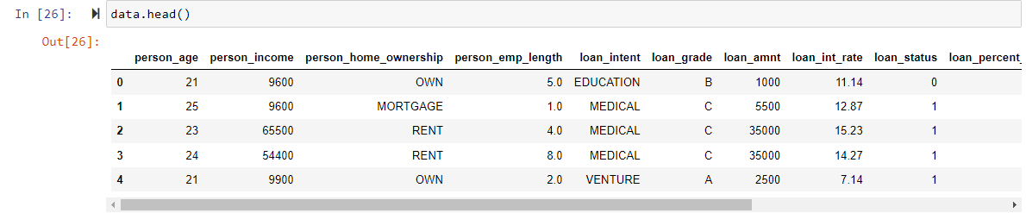
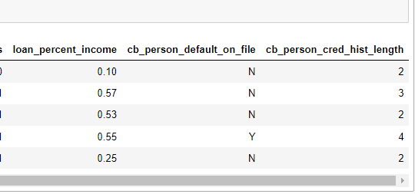
Describing the Dataset
Credit Risk Analysis Dataset: This dataset contains columns simulating credit bureau data
https://www.kaggle.com/datasets/laotse/credit-risk-dataset
32,581 records with 12 fields
Input Variable: Age, Income, Home ownership, Customer’s Employment length, Loan intent, Loan grade, Loan amount, Interest rate of the loan, Loan as a percent of income, Customers’ default history, Customers’ credit history length
Output variable: Loan Status (0 is non default and 1 is default)

Slide 4
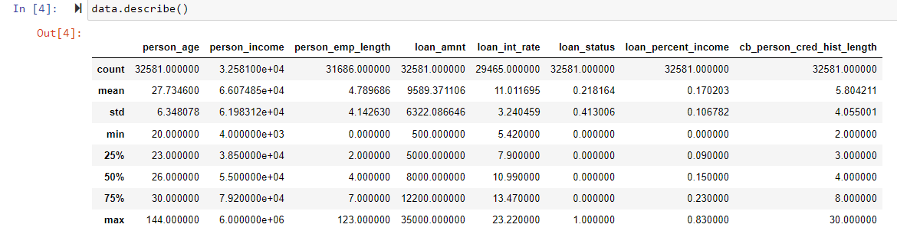
Descriptive Analysis
We drop all the values where work experience is greater than 70 and the values where age is greater than 100
Employment Length and Interest rate on the loan are the only variables that have missing values with 2.7% and 9.5% respectively

Slide 5
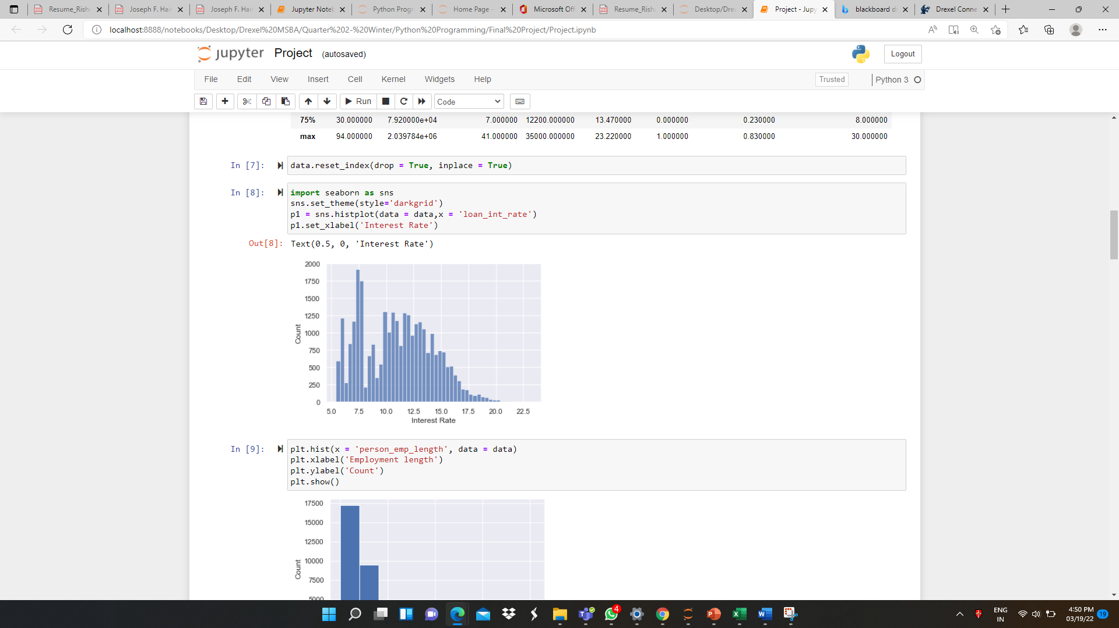
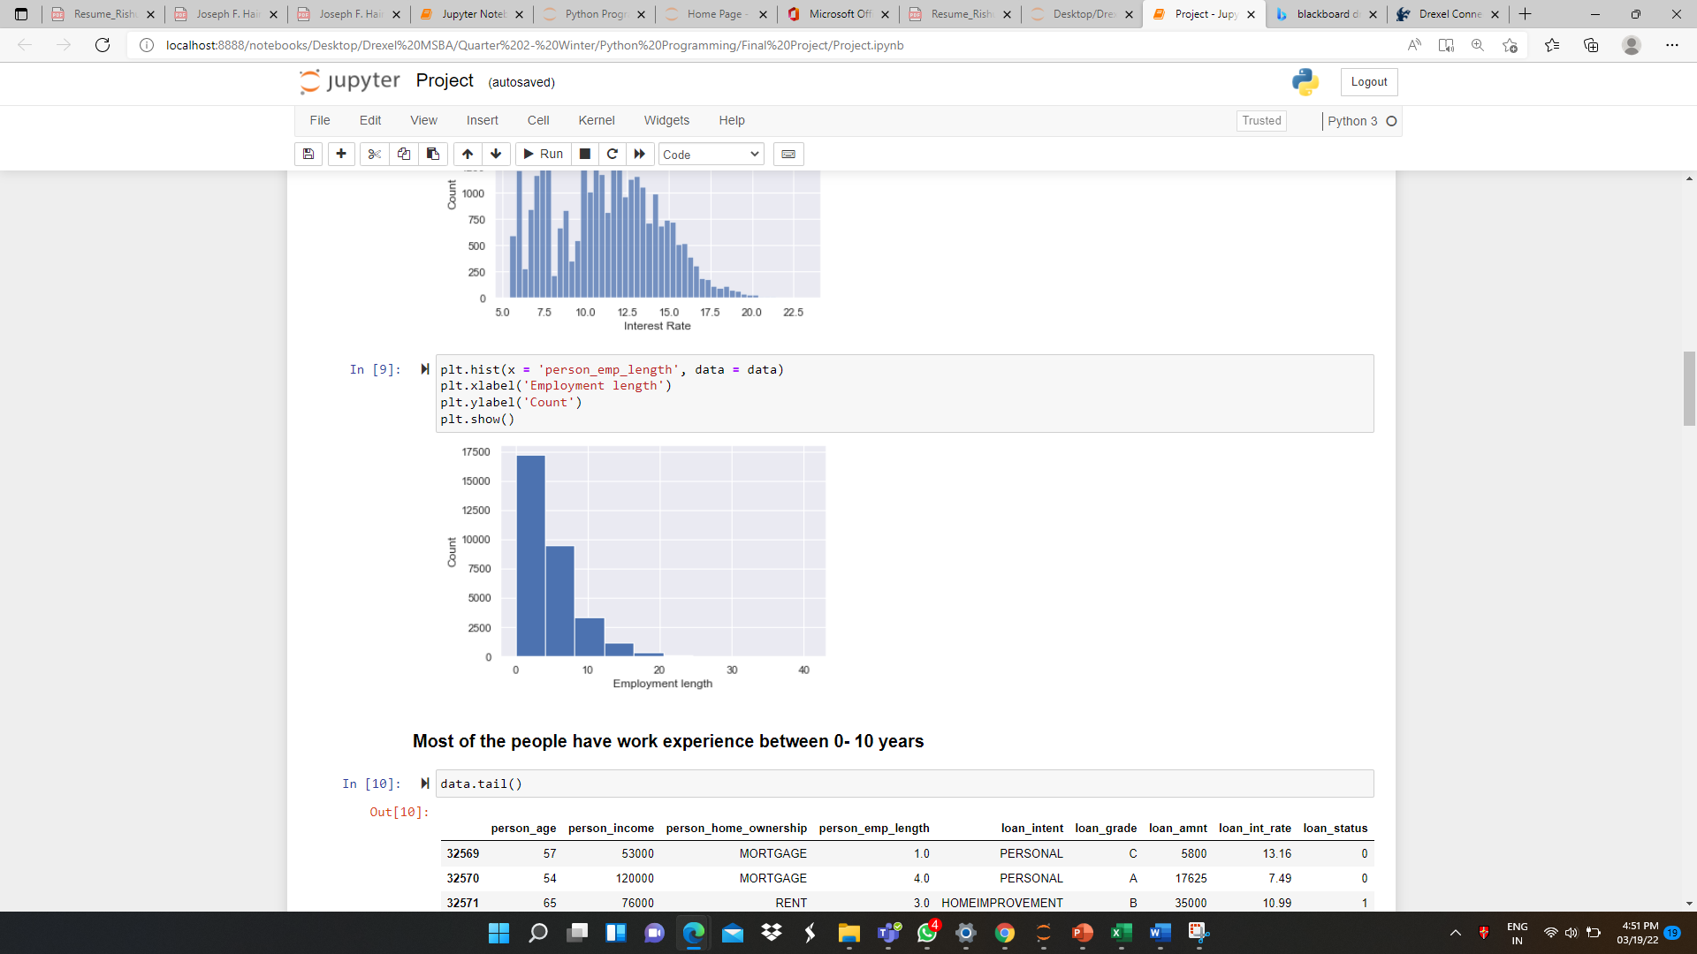
Data Visualization- Visualizing variables that have missing values
1
2
We can see both employee length and interest rate follows normal distribution, thus, we use median to impute null values
Most of the people have work experience between 0-10 years

Slide 6
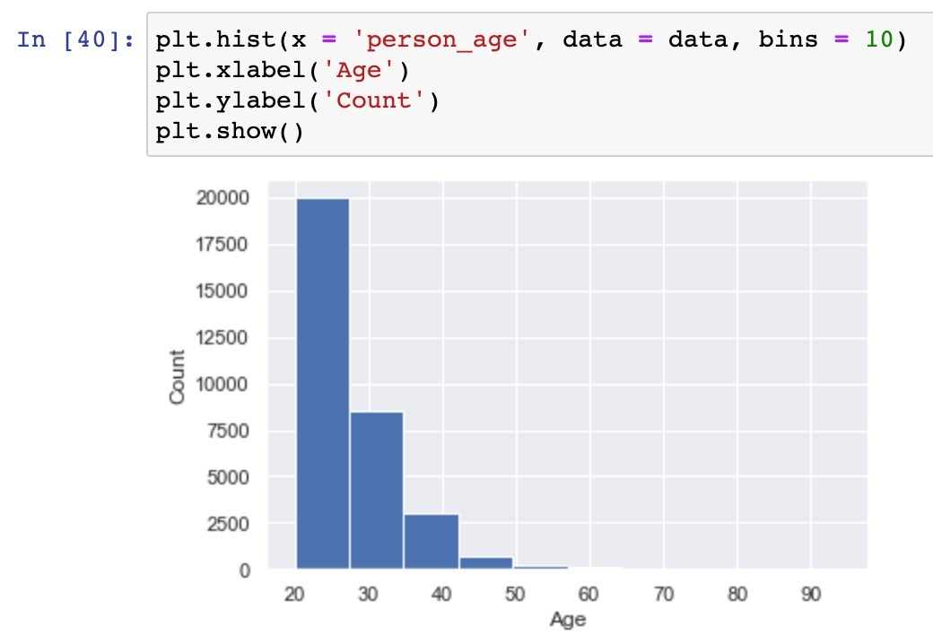
Data Visualization
3
The graph depicts major portion of the customers are aged between 20-30. Apparently this is the reason for having most customers with 0 to 10 years of employment.

Slide 7
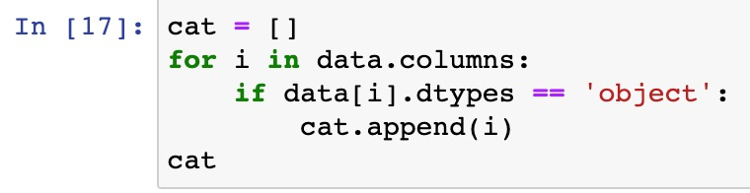
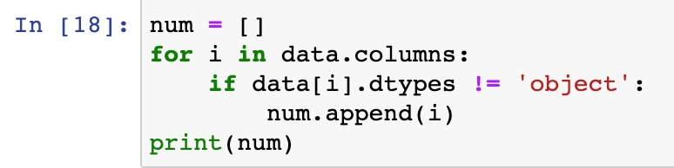
Variable Treatment
Categorical Variable
Numerical Variable
'person_age', 'person_income', 'person_emp_length', 'loan_amnt', 'loan_int_rate', 'loan_status', 'loan_percent_income', 'cb_person_cred_hist_length'
person_home_ownership', 'loan_intent', 'loan_grade', 'cb_person_default_on_file

Slide 8
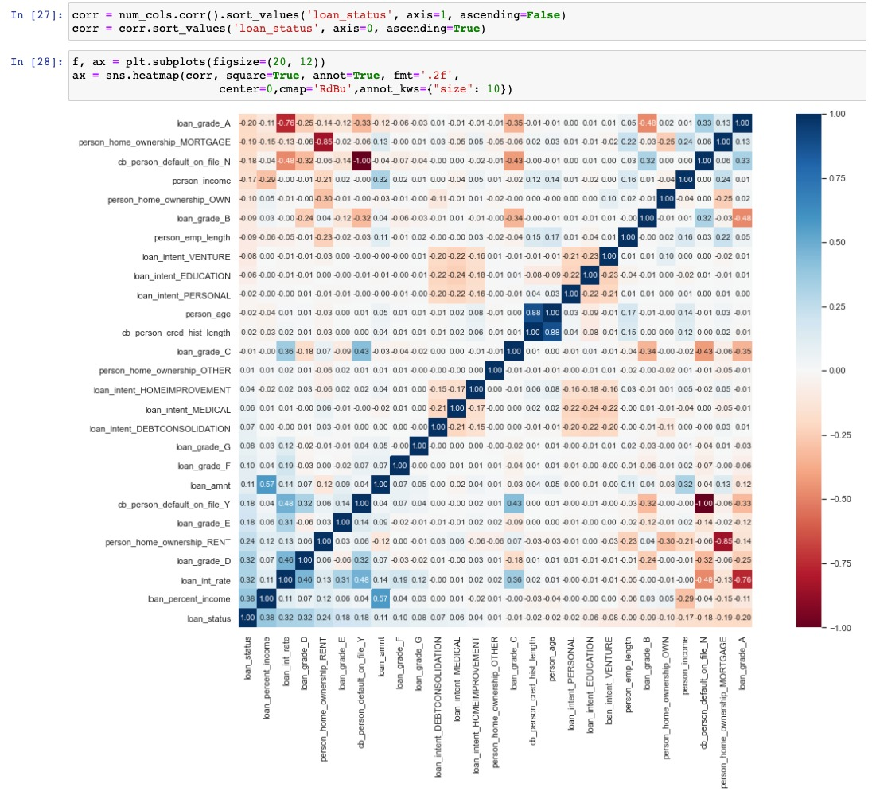
Correlation Matrix Heat Map

Slide 9
Correlation Matrix Heat Map- Insights
Income, employment length, and age all have a negative impact on loan status default, implying that the higher these factors are, the less risky the individual is
Loan percent income, loan int rate, and loan amount all have a positive impact on loan status being defaulted, hence the higher these variables are, the more riskier the individual is
Loan category D and E are riskier as they show the tendency to get default
Loan grid A is the one where minimum interest is charged whereas loan grid D is where the maximum interest is charged

Slide 10
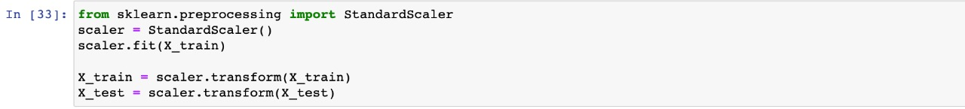
Model Development
Converting Dataset into Training and Test
The trained dataset has 24,430 datapoints (75%) whereas test dataset has 8,144 data points (25%)
Standardizing Input Variables
Standardizing the features by removing the mean and scaling to unit variance

Slide 11
Selecting the best parameters for prediction models
For hyperparameter tuning, we'll utilize the Exhaustive Grid Search method. It will take all the combination of parameters and provides us with the best possible combination
The best possible combination of parameters for KNN Model
1
The best possible combination of parameters for Random Forest Model
2

Slide 12
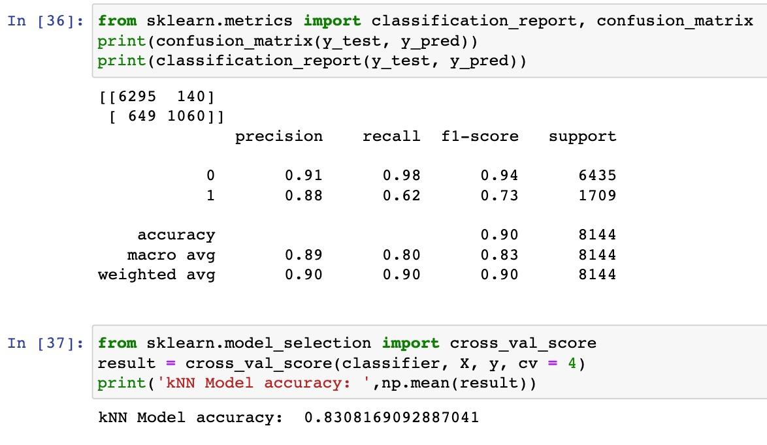
Machine learning algorithms: K-nearest Neighbors
Limitations of KNN
Results
KNN is the easiest form of machine learning algorithms for classification problems.
K in KNN represents the number of the nearest neighbors we used to classify new data points. Here K is 9 (Derived using Exhaustive Grid Search method)
Efficient with properly labeled, noise-free, and small dataset
KNN is not suitable for high dimensional large data
Sensitive to missing values and outliers
Accuracy is the proportion of true results, either true positive or true negative, in a population. So, 83% of the time our model has correctly predicted the defaulters

Slide 13
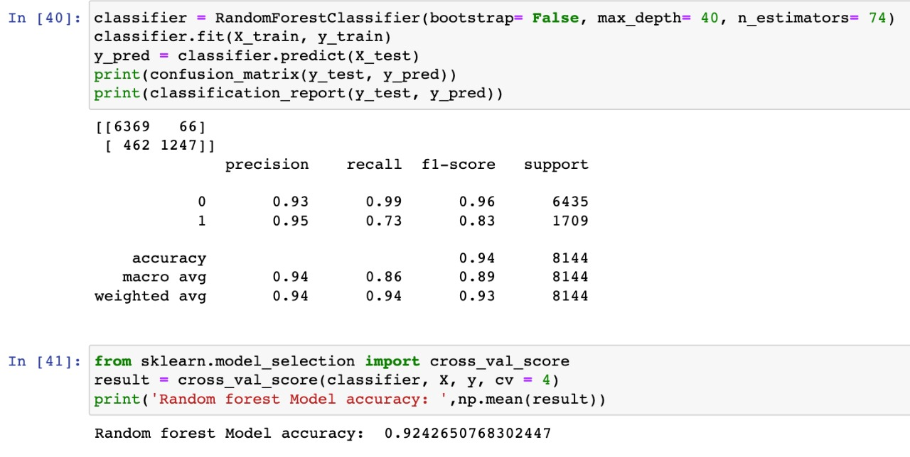
Machine learning algorithms: Random Forest
Limitations of Random Forest
Results
The Random Forest Algorithm combines the output of multiple (randomly created) Decision Trees to generate the final output.
It is good to deal with a large dataset.
It is a superior method for working with missing data
Random Forest has a higher training time than a single decision tree
Relatively difficult to interpret & understand than decision trees
92.42% of the time our model has correctly predicted the defaulters.

Slide 14
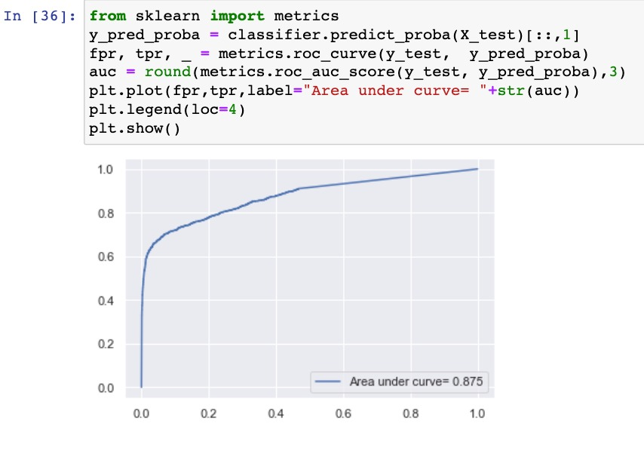
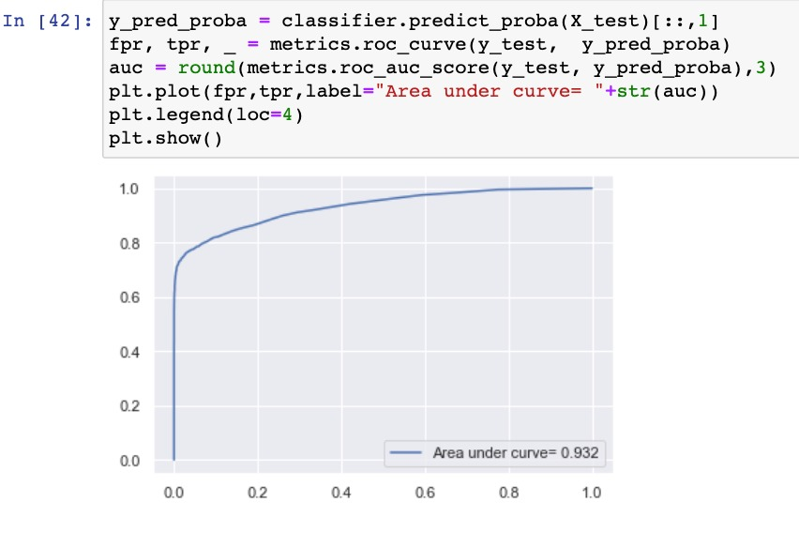
ROC Curve Comparison
ROC Curve shows the trade-off between sensitivity and specificity. If the curve is closer to the top-left corner then it indicates that the model is performing well
It is evident that ROC curve of Random Forest algorithm is closer to the top-left corner which indicates that Random Forest algorithm is relatively more accurate than KNN model

Slide 15
QnA
1
We did variable preprocessing for missing data, by imputing them with the median values.
How did you achieve variable preprocessing?
2
We did not perform feature selection because there were no metric variables with very high standard deviation and no categorical variables with 0 standard deviation.
How did you achieve feature selection?
3
3
We used accuracy, precison and recall as performance indicators, and after tuning the parameters of the model there was a significant change in our performance indicators.
What performance indicators did you use?
Did the performance indicator of the learning algorithm improve after feature selection? If yes, why? If no, why?
4
4
Our accuracy and precision increased after adjusting the parameters to a certain value which we achieved by Exhaustive grid search method.

